Slide 1


Slide 2







Project 4 – Group 8 ​
Mason DeJesus
Mathias Carnero
Andrew Montemayor
Judith Landa
Kids

Slide 3

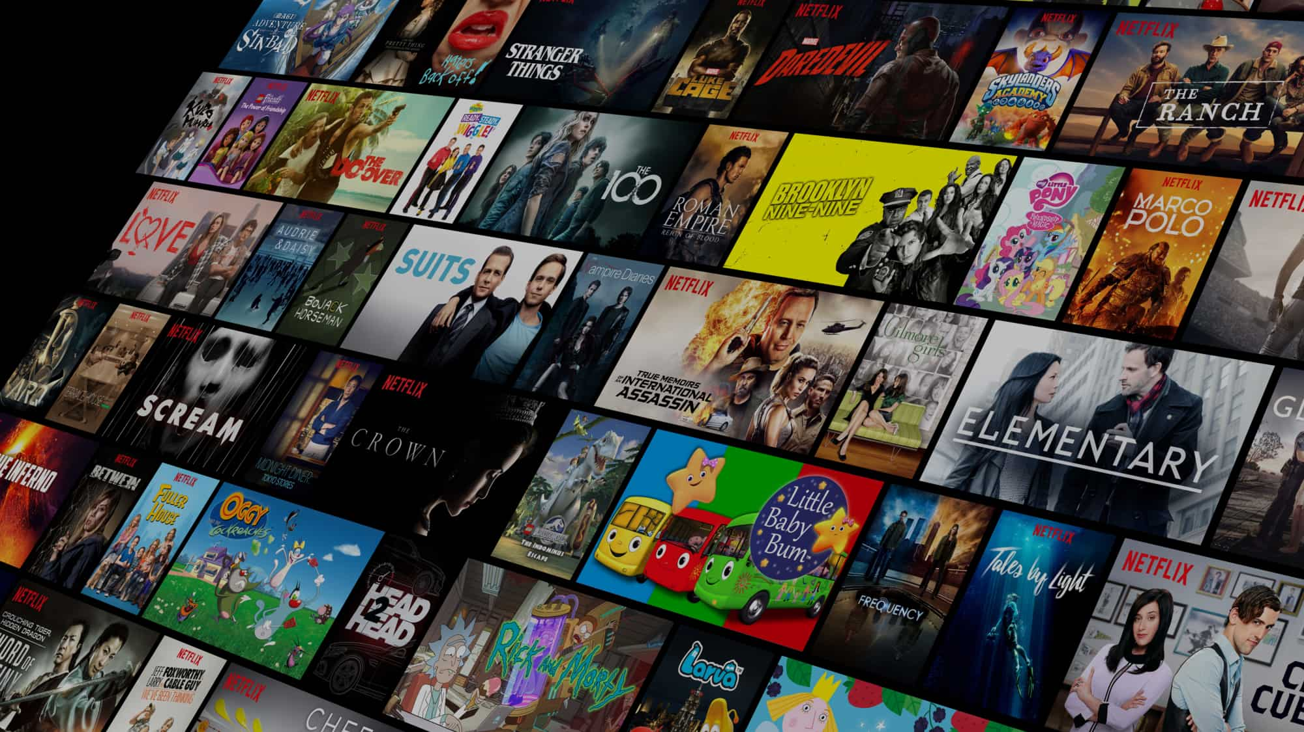
Purpose
Why we chose this dataset.
What we gain from analyzing the dataset
Our Focus

Slide 4
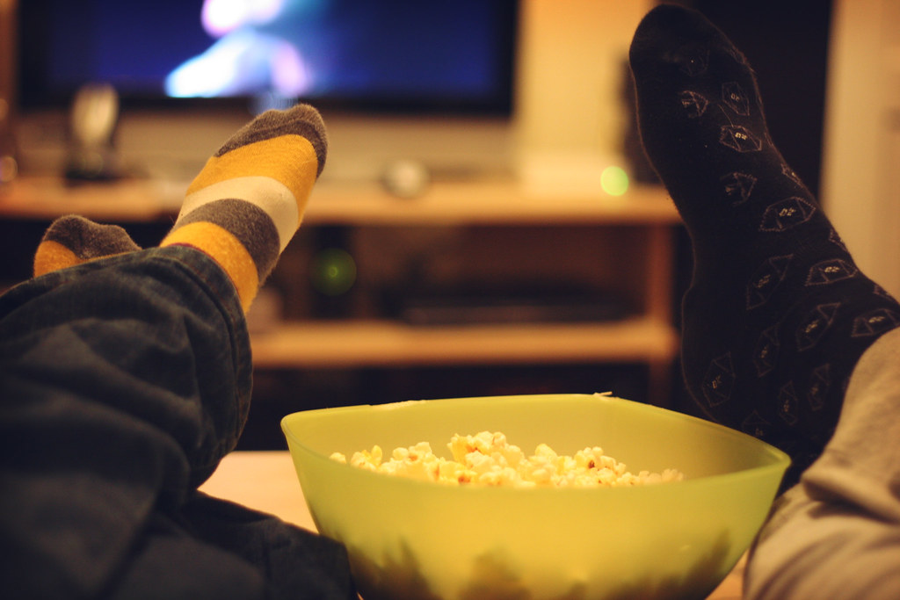
Inspiration
For our visualizations, we drew inspiration from several Tableau Public dashboards.
These examples showcase different approaches to analyzing time-series data and genre trends.
These sources guided us in designing dashboards that clearly show the patterns we wanted to explore in our dataset.

Slide 5
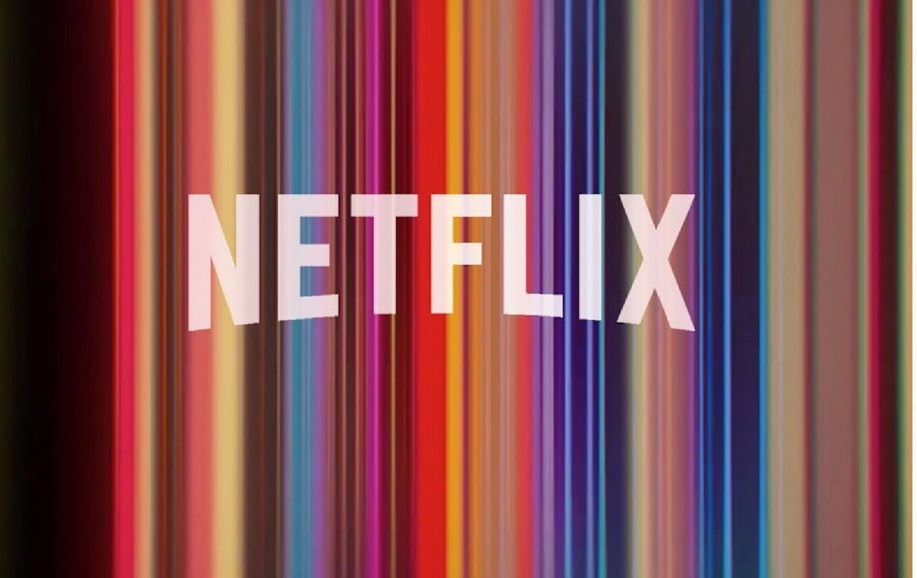
Design Concepts
Netflix-inspired design for a sleek, modern, and user-friendly interface.
Dark, contrasting color palettes create a cinematic look.
Visuals include bubble charts, heatmaps, and line charts to show ratings, votes, and genre trends.

Slide 6
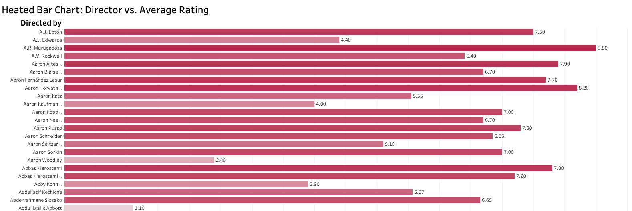
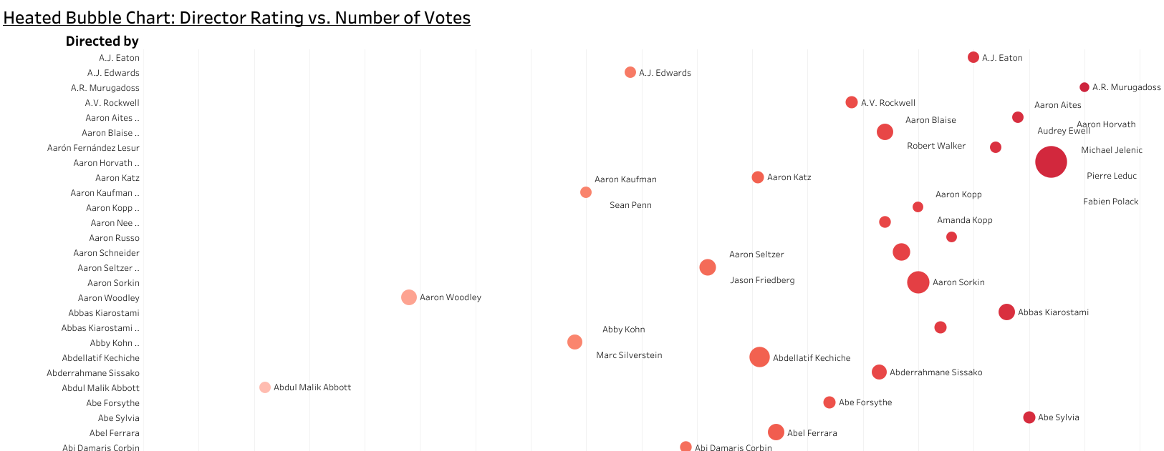
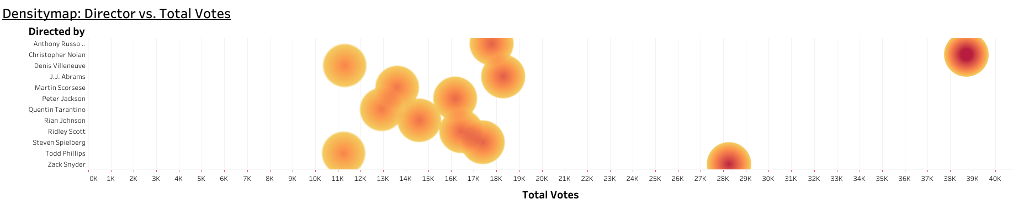
Research Question #1
Our analysis focused on two primary research questions:
First, which directors have the highest average ratings, the most votes, and which is the most "popular"?
Christopher Nolan
Steven Spielberg
Peter Jackson

Slide 7
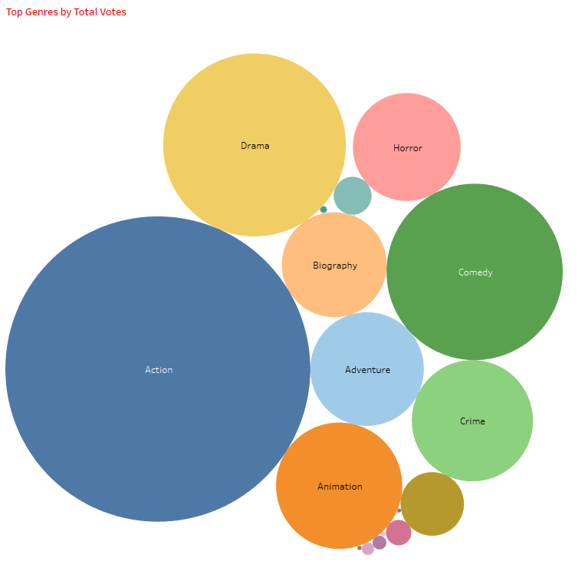
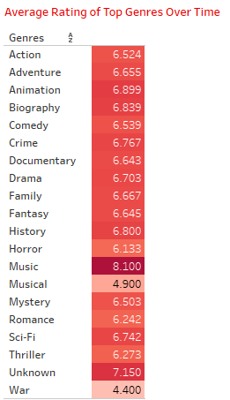
Research Question #2
What are the most popular genres over time, and how do their ratings compare?

Slide 8
LIVE DEMO
html pages on application
live ML page performs
BI visuals
Research questions
http://127.0.0.1:5000

Slide 9

Conclusions
Directors with higher average ratings tend to receive more votes, linking perceived quality with audience engagement.
Some genres maintain consistent popularity, while others fluctuate over time.
Platforms like IMDb and cultural factors influence which movies and directors gain the most attention, emphasizing the role of both quality and accessibility.

Slide 10

limitations/bias
As with any dataset, there are some limitations and biases to consider.
Time-period bias: Recent movies get more ratings due to easier access on modern platforms.
Cultural bias: Films from certain regions are overrepresented, which could skew results.
Rating aggregation bias: Averaging director ratings oversimplifies variations across their films.

Slide 11
Future Work
Looking ahead, we see several opportunities for expanding this project.
We could use machine learning models to predict future trends in movie genres and directorial success.
Incorporating additional factors, such as actor popularity or box office performance, could give us a more complete picture.
Lastly, addressing the biases we identified by weighing ratings or votes based on the time period or cultural context would provide more accurate insights.
These steps could further refine our analysis and help us draw even stronger conclusions.

Slide 12
Credits
Starring
Andrew Montemayor
Tableau Visualizations 1, Web App Development
Judith Landa
Tableau Visualizations 2, Slide Creation
Mason DeJesus
Machine Learning Models, Data Analysis
Mathias Carnero
Web App Hosting, Development Support
Andrew Montemayor, Judith Landa, Mason DeJesus, Mathias Carnero
Write-up
Produced By
Project 4, Group 8
Written By
Andrew Montemayor
Judith Landa
Mason DeJesus
Mathias Carnero
Special Thanks To
Kaggle
For providing the dataset of over 16,000 movies spanning from 1910-2024
Metacritic
For being the source of ratings and votes for the dataset
GitHub Community
For hosting the project repository and code
Tableau Public
For visualization inspiration and design ideas
Link to GitHub Repository: https://github.com/ajmonte0920/BootCamp24-project-4-group-08
Inspiration: https://public.tableau.com/app/profile/angela.drucioc/viz/TimeSeriesAnalyse/Tableaudebord2
https://public.tableau.com/app/profile/ryansoares/viz/TrendsinTVShowGenres/TrendsinTVShowGenres
https://public.tableau.com/app/profile/jules.claeys/viz/VancouverCanucksSeasonRecapSportsVizSunday/TeamDashboard
Color Theme: https://coolors.co/palette/353535-3c6e71-ffffff-d9d9d9-284b63
https://coolors.co/palette/0466c8-0353a4-023e7d-002855-001845-001233-33415c-5c677d-7d8597-979dac
https://coolors.co/palette/000000-14213d-fca311-e5e5e5-ffffff
https://coolors.co/palette/0d1321-1d2d44-3e5c76-748cab-f0ebd8
The End

Slide 13

Thank you for watching

